Slide 1

Web Request Life Cycle
Tenacious​

Slide 2

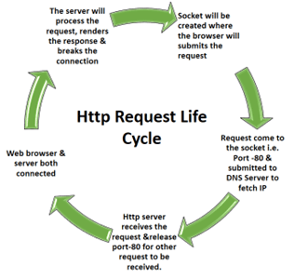
HTTP Request Life Cycle
Tenacious ​

Slide 3
Tenacious ​
Web Browser submits the request to the server after creating a socket in local progress.
The http server waits for the request to come on socket i.e. port-80.
The web browser translates the yahoo.com to an IP address if it does not knows it.
If the web browser does not recognize the address it contacts a DNS Server to resolve the name.
The browser will open a TCP connection to the IP address of yahoo.com and send a HTTP GET request over.
The request is then submitted to DNS server where IP address is fetched based on domain name.
Now the request is submitted to Http Server as per HTTP protocol.
Http server receives the request and shifts the client to another socket.
So the socket on port-80 is released to receive request from other clients.
Web Browser & server both are connected to each other.
The server will process the request, renders the response & breaks the connection.

Slide 4


